Slide 1
Intermediate Python
Data Structures, Algorithms & Object-Oriented Programming

Slide 2
Creating Python Code In VS Code
In this lecture we will:
Open VS Code
Create a python file

Slide 3
Opening VS Code
Launch Anaconda Navigator
REMEMBER: If you had to launch anaconda-navigator from the command line in the previous lectures, then that is how you must open it now. If you did not need to do this, then you can open it how you have been.
Then launch VS Code by pressing the ‘Launch’ button in the vs code square
You should see the following screen…

Slide 4
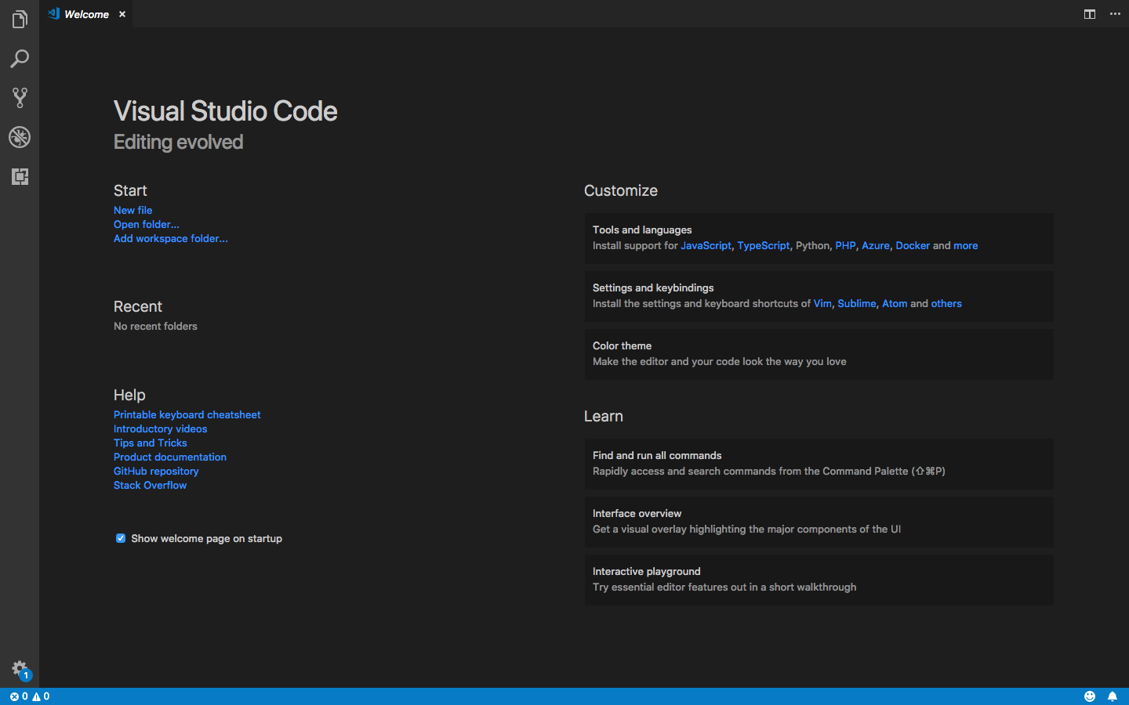
Opening VS Code

Slide 5
Adding a Workspace Folder
Great job! Now, we need to add a workspace folder.
A workspace folder is just a folder where your python code will live. You can create a folder for this course in your documents folder if you like.
Let’s do this on the next screen…

Slide 6
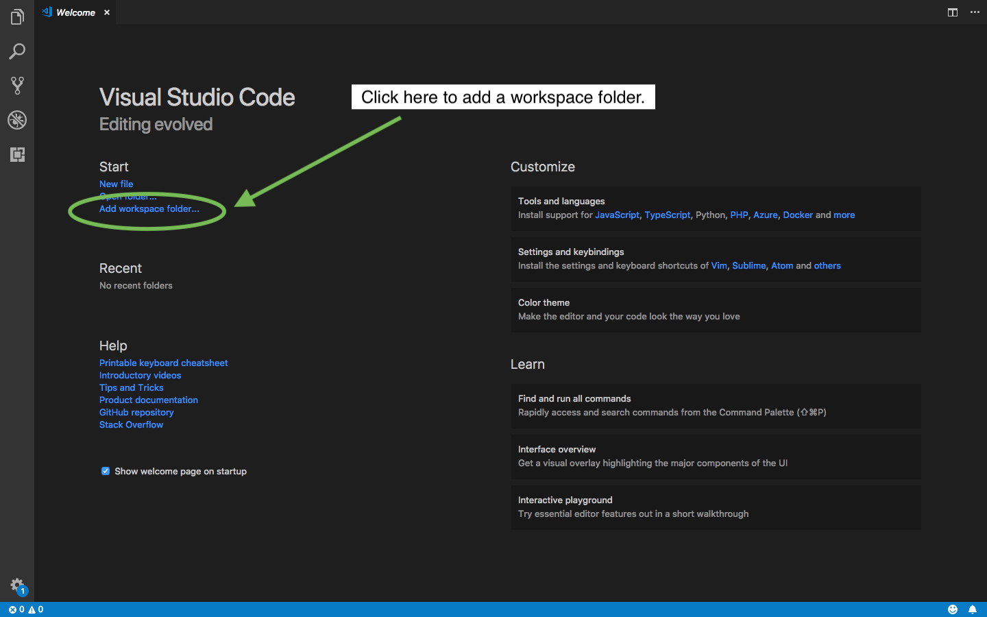
Adding a Workspace Folder

Slide 7
The File Explorer Side Bar
You should now see a side-bar on the left open up. This is the file explorer side bar and it should be showing the contents of your workspace folder, which will be nothing since we have not created a file yet.
Go ahead and click on ”New file” in the right hand window.

Slide 8
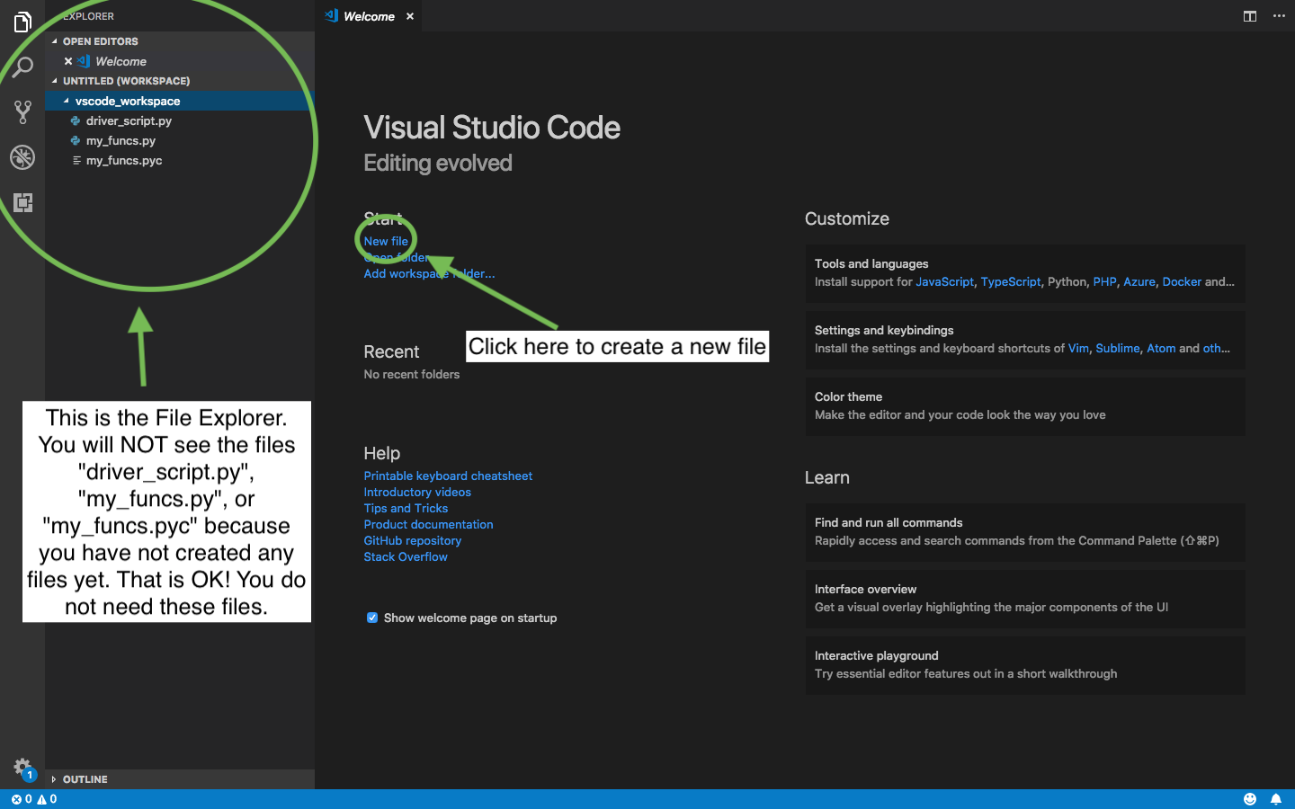
The File Explorer Side Bar

Slide 9
Creating New File
After you have clicked on ”New file” in the right hand window, you should see a tab open up, on the right, with the title like “Untitled”.
Now, save this file as “my_file.py”. This will save it to your workspace, and VS Code will automatically detect it as a Python file since it has the ‘.py’ extension.

Slide 10
The File Explorer Side Bar

Slide 11
Creating A New File
After you have clicked on ”New file” in the right hand window, you should see a tab open up, on the right, with the title like “Untitled”.
Now, save this file as “my_file.py”. This will save it to your workspace, and VS Code will automatically detect it as a Python file since it has the ‘.py’ extension.

Slide 12
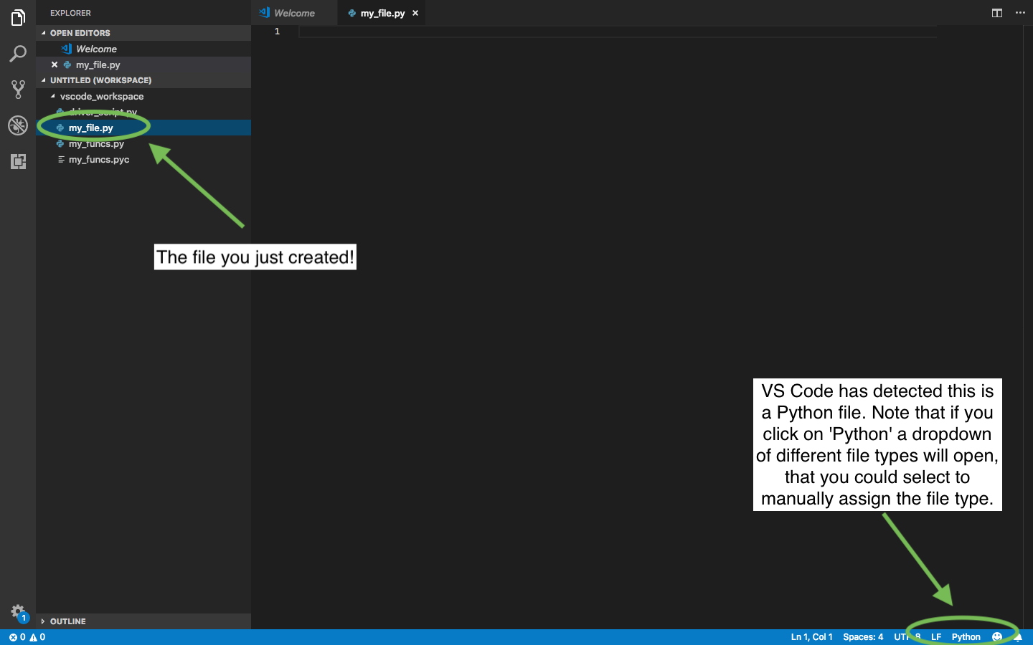
Creating A New File

